Slide 1

Smart Inventory and Warehouse Management Platform
CNAD Project Review-2
 | Under the Guidance of Mr. Madhu Guda Assistant Professor Department of CSE, KLH CSE Bowrampet Campus
Team Members Aashna Begum - 2420030647 K. Sree Vardhan - 2420030711 M. Asleshitha - 2420030740

Slide 2
Problem Statement
In modern supply chain and retail environments, effective inventory and warehouse management remains a significant challenge due to the reliance on manual processes, fragmented systems, and lack of real-time visibility. Many organizations struggle with issues such as inaccurate stock levels, delayed updates, overstocking, stockouts, and inefficient warehouse operations. These problems lead to increased operational costs, reduced productivity, and poor customer satisfaction. Additionally, the absence of integrated systems makes it difficult to track inventory movement, analyze data for decision-making, and respond quickly to changing demand patterns. Therefore, there is a need for a centralized, automated, and scalable solution that can provide real-time inventory tracking, streamline warehouse operations, and improve overall efficiency. The proposed Smart Inventory and Warehouse Management Platform aims to address these challenges by integrating modern technologies to ensure accurate data management, enhanced visibility, and optimized resource utilization within warehouse systems.

Slide 3
Objectives
Develop an automated and scalable system to improve inventory accuracy
Enable real-time stock tracking for better visibility of inventory movement
Reduce manual errors and enhance operational transparency
Streamline warehouse operations such as storage, retrieval, and dispatch
Improve efficiency and minimize delays in inventory handling
Prevent overstocking and stockouts using timely alerts and insights
Provide a centralized platform for managing inventory data
Support better analysis and informed decision-making
Ensure secure and easy system access with a user-friendly interface
Implement role-based access control for different users
Build a flexible and scalable system adaptable to future technologies
Enable integration with modern tools and evolving business needs

Slide 4
System Requirements
Functional Requirements
Real-time inventory tracking with automatic stock level updates across all warehouse locations
Role-based user management for admins, warehouse staff, and managers with secure login
Add, update, and remove stock entries with barcode/SKU-based identification
Automated low-stock and overstock alerts and notifications
Interactive analytics dashboard for reports, trends, and stock insights
Non-Functional Requirements
Scalability to support growing inventory volumes and multiple warehouse locations
High performance with fast query response even under concurrent multi-user access
Security through encrypted data storage, authentication, and role-based access control
Reliability and availability with minimal downtime and consistent data accuracy
Usability through a clean, intuitive, and responsive user interface

Slide 5
System Architecture & Design
User / Warehouse Staff
Frontend - React.js (Web UI)
Backend - Node.js / Spring Boot (REST APIs)
Database - MySQL / MongoDB
Cloud & Deployment - AWS / Docker
Data Flow: The user interacts with the React-based frontend, which sends REST API requests to the Node.js/Spring Boot backend. The backend applies business logic and validation, then reads from and writes to the MySQL/MongoDB database to fetch or update inventory records. Processed results and analytics are returned to the frontend for display on the dashboard.
The entire stack is containerized and hosted on a cloud platform (AWS/Docker), enabling scalability, high availability, and easy deployment of updates across environments.

Slide 6
Module-wise Description (1/2)
User Management Module
Handles secure login, registration, and role-based access for admins, warehouse staff, and managers, controlling what each role can view or modify.
Technologies: React (UI), Node.js/Spring Boot (auth APIs), JWT-based session handling.
1
Inventory Management Module
Allows staff to add, update, and remove stock items with SKU/barcode identification, maintaining accurate, real-time item-level records.
Technologies: React forms, REST APIs, MySQL/MongoDB for item and quantity records.
2
Warehouse Operations Module
Manages storage location mapping, retrieval, and dispatch workflows, tracking movement of goods within and out of the warehouse.
Technologies: Node.js/Spring Boot services, relational schema for bins and locations.
3

Slide 7
Module-wise Description (2/2)
Alert & Notification Module
Continuously monitors stock levels and automatically triggers low-stock, overstock, and expiry alerts to the concerned staff and managers.
Technologies: Scheduled backend jobs, email/push notification services, threshold rules engine.
4
Analytics Dashboard Module
Presents real-time reports, stock trends, and turnover insights through interactive charts, helping managers make data-driven decisions.
Technologies: React charting libraries, aggregation queries on MySQL/MongoDB data.
5

Slide 8
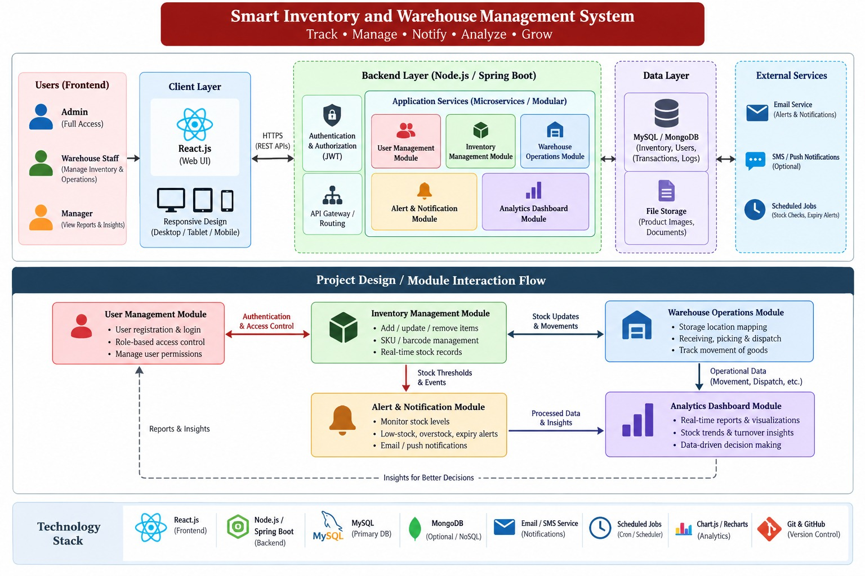

Slide 9
Module Integration
User
Frontend (React)
Backend (Node.js/Spring Boot)
Database (MySQL/MongoDB)
Dashboard
Integration Flow: The user interacts with the React frontend, which communicates with the Node.js/Spring Boot backend through secure REST APIs (JSON over HTTPS). The backend validates requests, applies business rules, and performs CRUD operations on the MySQL/MongoDB database. Processed data is returned to the frontend and rendered on the analytics dashboard in real time.
All modules (User Management, Inventory, Warehouse Operations, Alerts, and Analytics) expose their own API endpoints but share a common authentication layer and database, ensuring consistent, synchronized data across the platform.

Slide 10
Module Integration
1. Login
2. Add Inventory
3. Track Stock
4. Generate Alerts
5. View Dashboard
Login: Demonstrate secure sign-in with role-based access for admin and staff accounts.
Add Inventory: Show adding a new stock item with SKU, quantity, and warehouse location.
Track Stock: Display real-time stock levels updating across the inventory dashboard.
Generate Alerts: Trigger a low-stock scenario to show an automated notification being raised.
View Dashboard: Walk through analytics charts summarising stock trends and warehouse activity.
Expected Output Screens: Login screen, Inventory list/grid view, Add/Edit stock form, Alerts and notifications panel, and an interactive Analytics Dashboard with charts for stock levels, category-wise distribution, and recent activity.

Slide 11
Individual Contribution
Student | Focus Area | Key Contribution
Aashna Begum – (2420030647) | Backend / APIs | Designed REST APIs, business logic, and database integration for inventory and alert modules.
K.Sree Vardhan (2420030711) | Frontend / UI | Built the React-based UI, dashboard views, and user interaction flows for staff and admin roles.
M. Asleshitha (2420030740) | Database / Integration | Designed the database schema, handled module integration, and coordinated deployment on cloud.

Slide 12
Conclusion & Future Work
The Smart Inventory and Warehouse Management Platform successfully addresses the key challenges of manual, error-prone inventory processes by providing a centralized, automated, and real-time solution for tracking stock, managing warehouse operations, and generating actionable insights.
Through its modular architecture built on React, Node.js/Spring Boot, and MySQL/MongoDB, the system achieves accurate data management, timely alerts, and a user-friendly analytics dashboard, improving overall operational efficiency and decision-making for warehouse teams.
Future enhancements include integrating IoT-based sensors and RFID/barcode scanners for fully automated stock updates, adding predictive analytics for demand forecasting, supporting multi-warehouse and multi-tenant operations, and extending the platform with a dedicated mobile application for on-the-go inventory management.

